Slide 1
EXPLORING ORGANISATIONAL APPROACHES TO INTERNATIONAL MARKET ENTRY UNDER GLOBAL ECONOMY
Student ID: S24013995
Student Name: Rama Koteswara Rao Mangineni

Slide 2
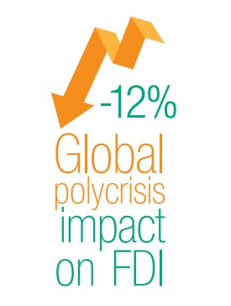
INTRODUCTION
The entry of organisations into international markets is increasingly affected by global economic volatility and policy uncertainty, challenging traditional approaches to market expansion.​
World FDI (Foreign Direct Investment) fell by about 12% to $1.3 trillion in 2022, remaining weak into 2023, indicating decreased investor confidence and widening investment disparities, particularly in developing countries.​
Research highlights uncertainty and poor governance as major factors reducing FDI, especially in regions with weaker institutional frameworks, requiring firms to reconsider their risk management strategies.​
Companies now face pressure to re-evaluate entry choices, emphasising resilience and effective risk-management in various host-country environments due to unstable global conditions.​

Slide 3

LITERATURE REVIEW
Recent studies show global uncertainty directly impacts the outcomes of internationalisation, influencing market entry success for organisations.​
Ogbonna et al. (2022) highlighted that, poor economic governance in host countries can worsen declining FDI flows, with policy instability making inward investment more vulnerable to macroeconomic shocks.​
As per Zhang et al. (2023), a 1% increase in global policy uncertainty can reduce inward FDI by up to 20%, underscoring the sensitivity of multinational investments to economic fluctuations.​
Institutional quality, governance, and risk levels in host nations play key roles in determining the timing and scale of organisational market entry.

Slide 4

LITERATURE REVIEW
Research reveals organisations are altering entry strategies under uncertainty, often relying on heuristics, experience, and business network ties for decision-making.​
As per Guercini and Milanesi (2022), managers increasingly choose entry modes, such as joint ventures and wholly owned subsidiaries, based on local capabilities and perceived risk, aiming for higher financial returns.​
Flexible, progressive entry strategies, mixing export, contractual, and equity modes, are advocated for better organisational control, learning, and resilience (Smith et al., 2021).​
According to Divrik, (2023), successful market entry relies on balancing risk and innovation through adaptive strategies that strengthen resilience against global economic shocks.

Slide 5
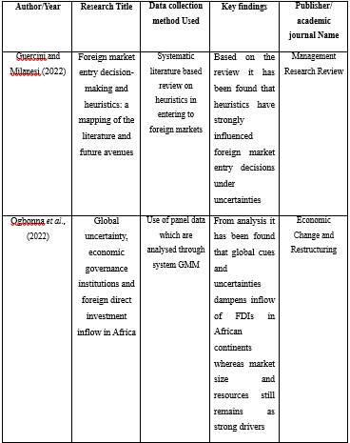
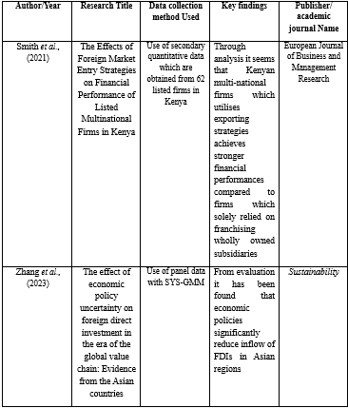
LITERATURE REVIEW MATRIX

Slide 6
REFERENCES
Divrik, B., 2023. International market entry strategies. In Origin and Branding in International Market Entry Processes (pp. 1-10). IGI Global.
Guercini, S. and Milanesi, M., 2022. Foreign market entry decision-making and heuristics: a mapping of the literature and future avenues. Management Research Review, 45(9), pp.1229-1246.
Ogbonna, O.E., Ogbuabor, J.E., Manasseh, C.O. and Ekeocha, D.O., 2022. Global uncertainty, economic governance institutions and foreign direct investment inflow in Africa. Economic Change and Restructuring, 55(4), pp.2111-2136.
Smith, C., Ogutu, M., Munjuri, M. and Kagwe, J., 2021. The Effects of Foreign Market Entry Strategies on Financial Performance of Listed Multinational Firms in Kenya. European Journal of Business and Management Research, 6(3), pp.216-225.
UNCTAD, 2023. WORLD INVESTMENT REPORT 2023. [online] UNCTAD. Available at: https://unctad.org/system/files/official-document/wir2023_en.pdf [Accessed 20 Nov. 2025].
Zhang, B., Ma, J., Khan, M.A., Repnikova, V., Shidlovskaya, K., Barykin, S. and Ahmad, M.S., 2023. The effect of economic policy uncertainty on foreign direct investment in the era of global value chain: Evidence from the Asian countries. Sustainability, 15(7), p.6131.

Slide 7
THANK YOU

